Slide 1
Implementing a pipeline

Slide 2
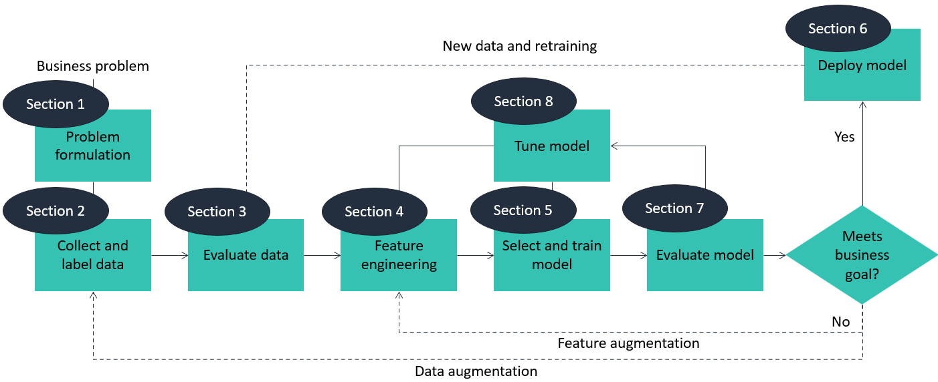
First do module 3 on AWS
Notes:
It’s long and hard, but also very important.

Slide 3
First do module 3 on AWS
Section 1: Nice to know, you did the exercises before
Section 2:
Nice to know, but try to keep track of all the AWS-lingo
No exercises in the folder
Tryout amazon Sagemaker
Section 3:
Need to know, but really “should already know”
Introduces pandas! (entire section should be very familiar)
Also talks about correlation, which will be a main topic later on here
Also do the sagemaker lab

Slide 4
First do module 3 on AWS
Section 4:
Need to know
Dive deeper into pandas, but more on data than section 3
No exercises in the folder, but another sagemaker lab
Section 5:

Slide 5
Correlation
Also correlation matrix

